Slide 1


Capstone Project Phase 2
Outline of liver tumors based on image segmentation
Supervisor:
Professor Miri Weiss Cohen
Submitters:
Aviel Malayev – aviel410aviel@gmail.com
Omri Shalev – shalevomri10@gmail.com
Notes:
Hello, good afternoon.
My name is Omri Shalev, and with me is Aviel Malayev.
We are excited to present our research on "Outline of Liver Tumors Based on Image Segmentation."
Before we explain the details of our project, let's take a moment to understand the significance of liver tumors and the challenges they pose.

Slide 2
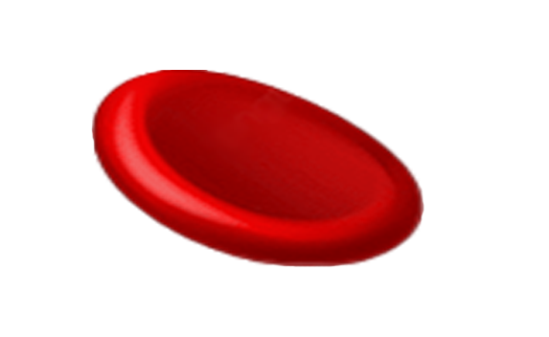
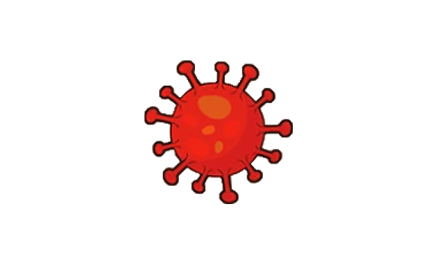
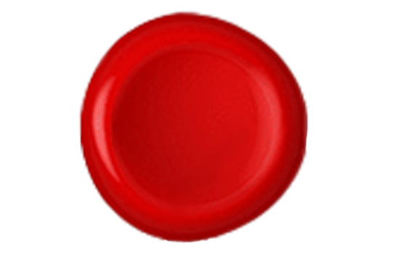
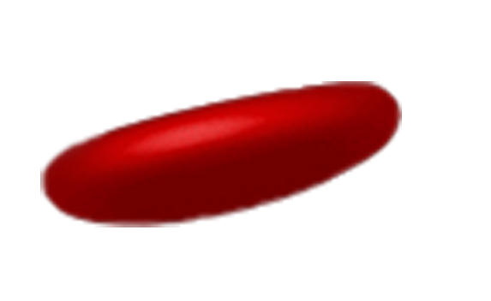
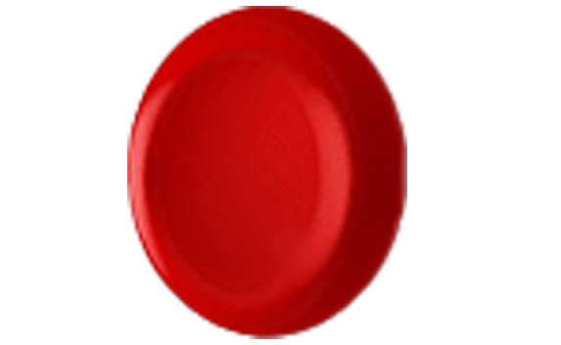


Table of Contents
Introduction
Proposed approach
Background
Pre-process
Process
Our Approach
Conclusion
Demonstration
Notes:
These are the subjects we will talk about today.

Slide 3
Introduction

Slide 4
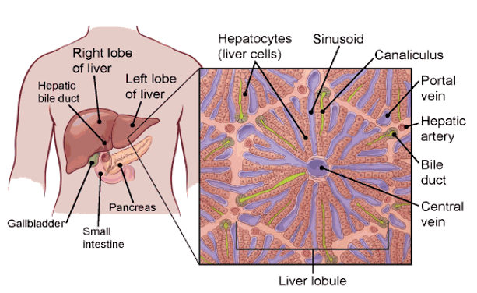
The Liver
The liver is the largest internal organ (size of a football).
The liver lies under the right ribs just beneath the right lung and it has two lobes (sections).
The liver is a vital organ that performs various important functions in the body:
Filtering toxins from the blood.
Storing energy in form of glycogen.
Producing bile to aid in digestion.
Notes:
The liver is the largest internal organ in the human body. (Size of a football).
It is located under the right ribs.
And plays a crucial role in our lives:
Acts as a filter - removing toxins from our bloodstream.
Stores energy in the form of glycogen.
Produces bile to aid in digestion.

Slide 5
Liver Cancer
Liver cancer ranked seventh among the most diagnosed cancers and ranked second leading cause of cancer-related deaths worldwide in 2020.
The most common type (75% of cases) of liver cancer is hepatocellular carcinoma (HCC).
Liver cancer that starts in another organ and spreads to the liver is more common than liver cancer that originates in the liver itself.
Common symptoms of liver cancer include:
Abdominal pain.
Jaundice (yellowing of the skin and eyes).
Fatigue(persistent tiredness of weakness).
Weight loss.
Loss of appetite.
Notes:
Some details about the liver cancer itself:
The liver cancer ranked 7th in the diagnosed cancers around the world in 2020.
In addition, it ranked 2nd in the death cases among the cancer-related deaths in 2020.
The most common type of liver cancer is hepatocellular carcinoma (HCC), which is around 75% of the cases.
It's important to note that liver cancer can either originate in the liver or spread from other organs to the liver.
Common symptoms include:
- abdominal pain
- jaundice
- fatigue
- weight loss
- loss of appetite.

Slide 6
Risks & Treatments
Risks factors for hepatocellular carcinoma (HCC):
Chronic infection with Hepatitis B or C.
Heavy alcohol consumption.
Excess body weight.
Type 2 diabetes.
Smoking.
Treatments for HCC include:
Surgery.
Chemotherapy.
Radiation therapy.
Targeted therapy.
Immunotherapy.
Notes:
Risks associated with hepatocellular carcinoma (HCC) include:
Chronic Hepatitis B or C infection
Heavy alcohol consumption
Excess body weight
Type 2 diabetes
Smoking.
Treatment options for liver cancer include:
Surgery
Chemotherapy
Targeted therapy
Immunotherapy.
Radiation therapy – which we focused on our project.

Slide 7
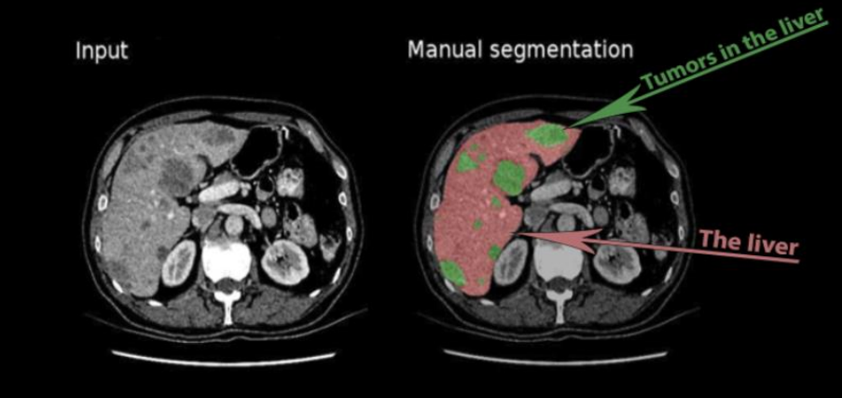
The Procedure:
CT scan: Precise imaging of tumors and surrounding areas.
Manual outlining: The tumors and areas to be avoided from are manually outlined by medical professionals.
Radiation plan development: Based on the manual outlines, a radiation plan is developed.
Treatment delivery: The radiation therapy is administered according to the outlined areas.
The Problem:
Accuracy errors due to human factors.
Tedious and time-consuming.
The Solution:
Manuel outlining has limitations:
Radiation Therapy
Automation.
Notes:
First, let's start with the procedure:
The patient is going to do a CT scan of the liver area.
Then, there is a manual outlining of the tumors and the surrounding tissues by medical professionals.
Based on the manual outlines, radiation plan is developed.
And at last, deliver the radiation therapy to the patient.
So, what is radiation therapy?? It’s a procedure that uses X-rays beams to burn the tumors inside the body, so it's extremely important to make an accurate segmentation.
So, what is the problem??
Manuel outlining has limitations such as:
Accuracy errors due to human factors which can happen due to tiredness, lack of experience or wrong opinion.
Also, this process is tedious and time-consuming.
Therefore, our solution is automation.
By automating the outlining process, we can eliminate the potential for human error and reduce the time and effort required.

Slide 8
Motivation:
The application of machine learning in the medical field is a relatively new field.
Proposed Solution:
To conduct a comprehensive analysis on variants of U-net architectures which are used for liver tumor segmentation and evaluate their performance.
Implement a system with the best-performing architecture and optimal hyperparameters determined during the comparison phase.
Motivation & Proposed Solution
Notes:
Motivation: Accurate liver tumor segmentation using this technology remains a challenging problem that requires exploration and improvements.
Why Is it a challenging problem? – because it suffers from a low score due to low contrast, vague boundaries between the tumors and surrounding tissues as well as the wide variations of the tumors in intensity, shape, and location across patients

Slide 9
Background
Notes:
challenging task: for computers due to the diverse shapes, sizes, colors, textures, occlusions, and complex backgrounds.
1) Thresholding is a basic segmentation technique where pixels are divided into two segments based on a threshold value.
2) Adaptive Region Growing (ARG) starts with seed points and grows regions by adding adjacent pixels based on criteria like color and texture similarity.
3) Graph cut is a common method using graph representation, where nodes represent pixels and edges represent the similarity between pixels based on metrics like color and distance.
4) CNN-based segmentation models classify each pixel separately to the corresponding class, providing localization and segmentation.

Slide 10
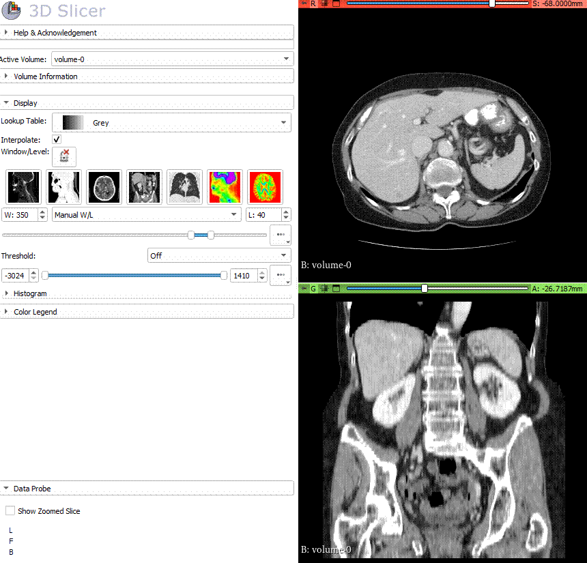
CT
CT (Computer Tomography) is a computerized X-ray procedure that produces detailed images of the body.
CT scans diagnose conditions like broken bones, tumors, heart diseases, strokes and more.
Digital X-ray detectors transmit X-rays to a computer, which constructs 2D image slices.
Contrast agents is a substance that enhance the visibility of difficult-to-see soft tissues in CT scans.

Slide 11
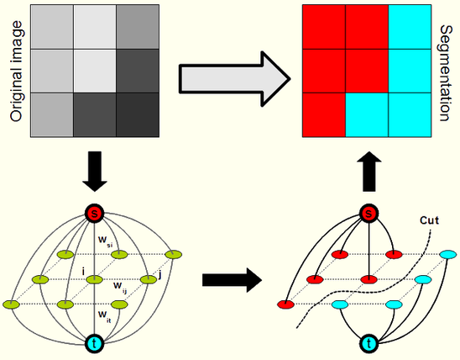
Image Segmentation
The process of dividing an image into different regions, poses a challenging task
In computer vision, various segmentation algorithms are utilized, including:
Thresholding.
Adaptive Region Growing (ARG).
Graph Cut.
CNN-based segmentation.
Graph cut example
Notes:
challenging task: for computers due to the diverse shapes, sizes, colors, textures, occlusions, and complex backgrounds.
1) Thresholding is a basic segmentation technique where pixels are divided into two segments based on a threshold value.
2) Adaptive Region Growing (ARG) starts with seed points and grows regions by adding adjacent pixels based on criteria like color and texture similarity.
3) Graph cut is a common method using graph representation, where nodes represent pixels and edges represent the similarity between pixels based on metrics like color and distance.
4) CNN-based segmentation models classify each pixel separately to the corresponding class, providing localization and segmentation.

Slide 12
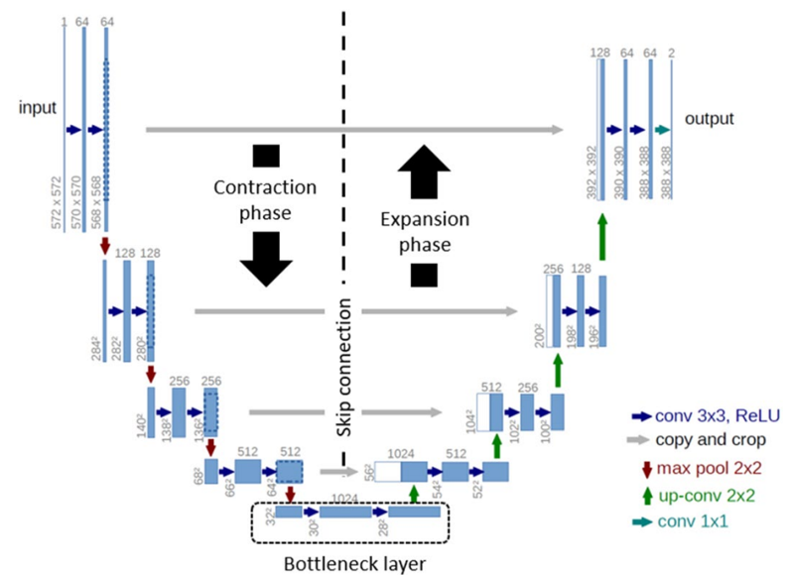
U-net
A CNN-based segmentation model was originally developed for the medical field.
U-Net is proposed to classify each pixel as part of the target region or background, using an encoder-decoder architecture.
The encoder extracts features through convolutional and pooling layers, while the decoder reconstructs the image using deconvolution layers.
Skip connections are utilized to preserve location information by concatenating corresponding layers from the encoder to the decoder.

Slide 13

U-net – Convolution
The Convolution Process:
A filter is applied to the image.
Calculating the dot product between the filter and the receptive pixel of the image.
The dot product result is then fed into an output.
The filter moves to the next pixel area.
The process is repeated across the entire image until a final output, also known as a feature map, is obtained.
Notes:
*

Slide 14
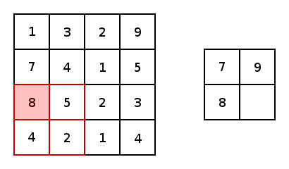
U-net – Pooling & Skip Connections
Pooling:
In U-net, the pooling function is typically max pooling.
Max pooling reduces the resolution of the input without losing the most significant value from the region.
Skip Connections: Concatenation plays a crucial role in the U-net as it combines two essential aspects:
1. Features extracted through up-sampling
2. Feature localization from the opposite convolutional layer.

Slide 15
Pre-Process
Notes:
challenging task: for computers due to the diverse shapes, sizes, colors, textures, occlusions, and complex backgrounds.
1) Thresholding is a basic segmentation technique where pixels are divided into two segments based on a threshold value.
2) Adaptive Region Growing (ARG) starts with seed points and grows regions by adding adjacent pixels based on criteria like color and texture similarity.
3) Graph cut is a common method using graph representation, where nodes represent pixels and edges represent the similarity between pixels based on metrics like color and distance.
4) CNN-based segmentation models classify each pixel separately to the corresponding class, providing localization and segmentation.

Slide 16
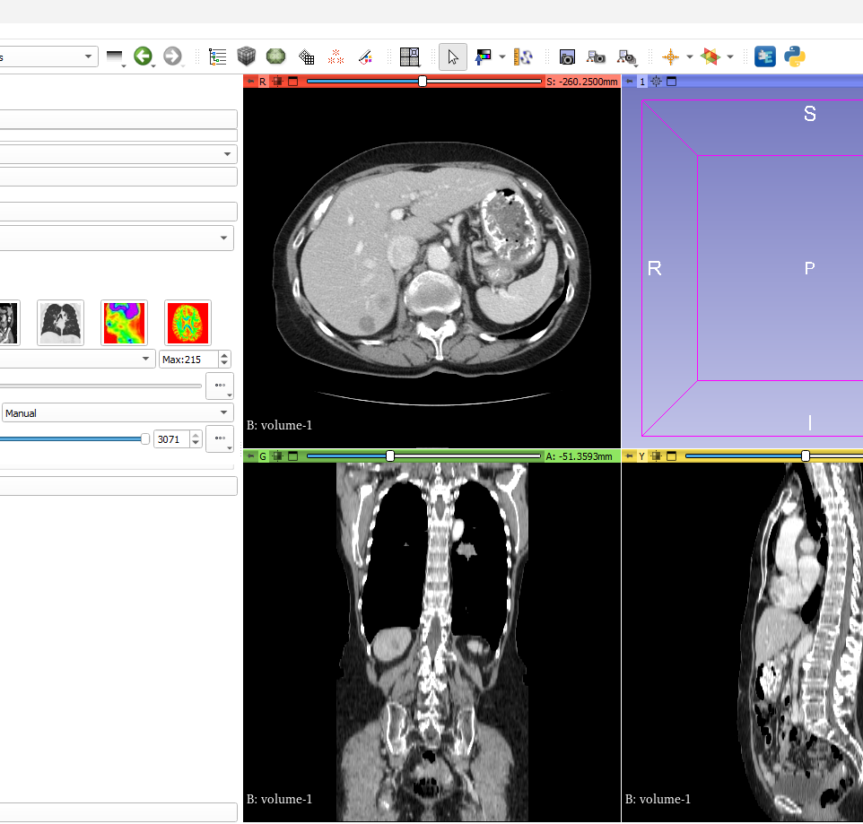
Dataset
We utilize the LiTS17 dataset, obtained from Kaggle.
Size: 50 3D CT scans of patients.
Format: NIfTI-1 files (.nii).
To view and analyze the images we used the "Slicer" program.
Notes:
So… Our Dataset is LiTS17, which we have found on Kaggle.
The dataset consists of 50 3D CT scans of patients with liver tumors.
The scans are provided in NIfTI-1 file format (.nii)
for viewing and analysis, we used the "Slicer" program, which is a powerful tool for medical image visualization.

Slide 17
Dataset
Image Cropping
Cropped all images to a uniform resolution of 255x255 pixels, ensures consistency in input size for the models.
Data Augmentation
Implemented rotation to increase dataset variability.
Slices Filtering
Applied threshold to use only slices with sufficient content.
Notes:
OK, so before we could use the dataset in our models, we had to prepare it first.
Image Cropping: We cropped all images to a uniform resolution of 255x255 pixels. This step is important because it makes sure all images have the same size, which is necessary for the models to work correctly.
Data Augmentation: To make our dataset more robust, we introduced variations through data augmentation. Specifically, we implemented rotation to increase the variability of the dataset. This helps the model learn to recognize tumors from different angles and positions.
Slices Filtering: We applied a threshold to filter out slices that don’t have enough relevant content. This means we only kept the slices that show significant parts of the liver and tumors, which makes our model training more focused and efficient.

Slide 18
Dataset
Applied Hounsfield Unit (HU) normalization across all images, enhancing contrast and detail visibility.
Quality Control
Manually inspected and removed images with incorrect masks, reducing noise and potential training biases.
Normalization
Notes:
Normalization: We applied Hounsfield Unit (HU) normalization across all images. This improves the contrast and detail visibility in the images, as you can see in the example here.
Quality Control: we manually inspected the dataset and removed images with incorrect masks. This step reduces noise and potential training biases, ensuring that our models learn from the best quality data.

Slide 19
Process
Notes:
challenging task: for computers due to the diverse shapes, sizes, colors, textures, occlusions, and complex backgrounds.
1) Thresholding is a basic segmentation technique where pixels are divided into two segments based on a threshold value.
2) Adaptive Region Growing (ARG) starts with seed points and grows regions by adding adjacent pixels based on criteria like color and texture similarity.
3) Graph cut is a common method using graph representation, where nodes represent pixels and edges represent the similarity between pixels based on metrics like color and distance.
4) CNN-based segmentation models classify each pixel separately to the corresponding class, providing localization and segmentation.

Slide 20
Hyper-Parameters
Loss Functions:
Binary Cross-Entropy.
Weighted Binary Cross-Entropy.
Dice Loss.
Learning Rates:
0.001
0.0001
0.00001
Epochs: 40
Batch Size: 32
Optimizer: Adam

Slide 21
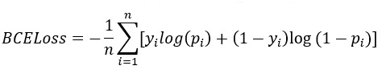
Hyper-Parameters
Binary Cross-Entropy (BCE)
Purpose:
Fundamental loss function.
Why BCE?:
A solid baseline from which to assess and refine the model's performance.
Functionality:
Measures the divergence between predicted probabilities and actual binary outcomes.
Notes:
Purpose: Serves as a fundamental loss function for binary classification.
Why BCE?: We chose BCE because it's a time-tested method that provides a solid baseline from which to assess and refine the model's performance
Functionality: Measures the divergence between predicted probabilities and actual binary outcomes.

Slide 22
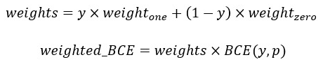
Hyper-Parameters
Weighted Binary Cross-Entropy
Purpose:
Focusing more on rarer, critical features such as tumors.
Enhancement:
Modifies BCE by applying weights.
Configuration:
Weight_one = 1.0
Weight_zero = 0.625
Notes:
Purpose:
Addresses class imbalance by focusing more on rarer, critical features such as tumors.
Enhancement:
Modifies BCE by applying different weights to the classes, enhancing the detection of less frequent values denoted as tumors.
Configuration:
Weight_one = 1.0 , Weight_zero = 0.625

Slide 23
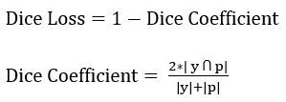
Hyper-Parameters
Dice Loss
Purpose:
Enhances alignment between predicted segmentation and ground truth.
Why Dice?:
Commonly used in medical datasets where imbalance exists.
Relevance:
Precise and clinically useful segmentations
Notes:
Purpose:
Enhances alignment between predicted segmentation and ground truth.
Why Dice?:
Commonly used in medical datasets where imbalance exists
Relevance:
Directly related to segmentation quality, improvements in Dice scores translate to more precise and clinically useful segmentations

Slide 24
U-net
A CNN-based segmentation model was originally developed for the medical field.
U-Net is proposed to classify each pixel as part of the target region or background, using an encoder-decoder architecture.
The encoder extracts features through convolutional and pooling layers, while the decoder reconstructs the image using deconvolution layers.
Skip connections are utilized to preserve location information by concatenating corresponding layers from the encoder to the decoder.

Slide 25
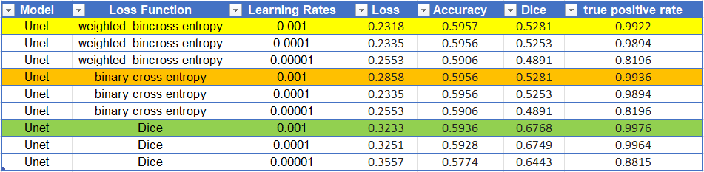
U-net Results

Slide 26
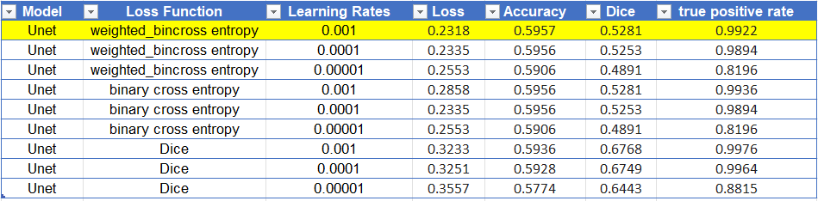
U-net Results

Slide 27
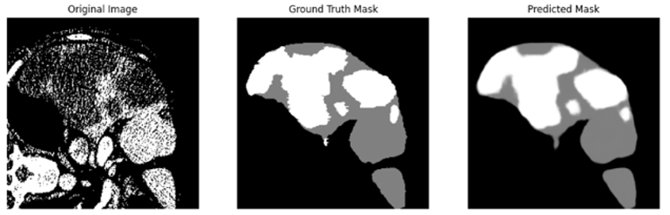
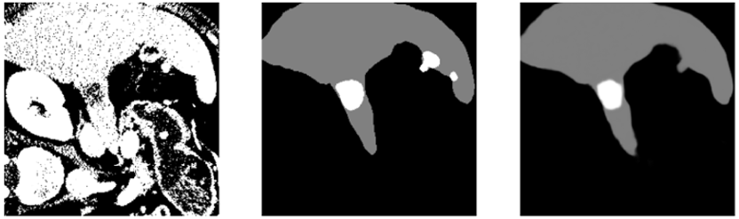
U-net Results

Slide 28
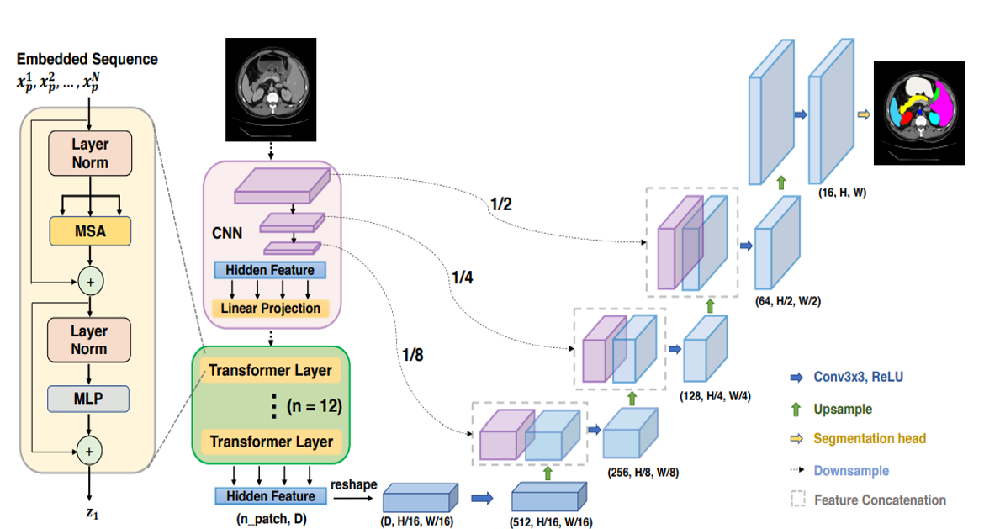
Trans-U-net
Combines Transformers and U-net which offering a strong alternative for medical image segmentation.
Uses a CNN-Transformer hybrid model in the encoder phase.
The CNN extracts detailed high-resolution spatial information.
The Transformer capture long-range dependencies and contextual relationships through self-attention.

Slide 29
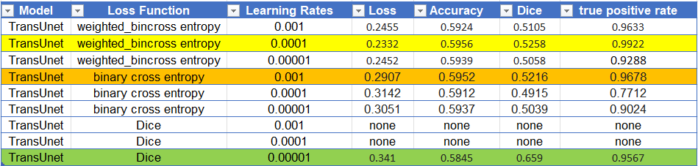
Trans-U-net

Slide 30
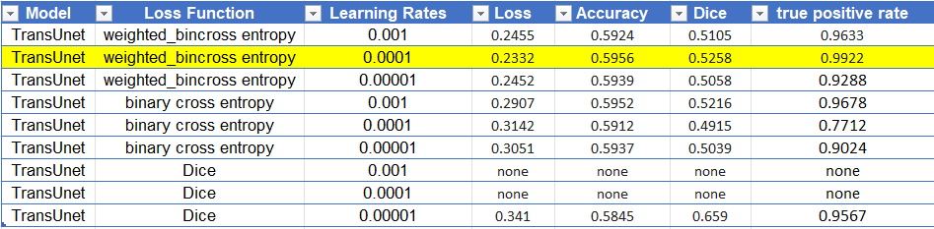
Trans-U-net

Slide 31
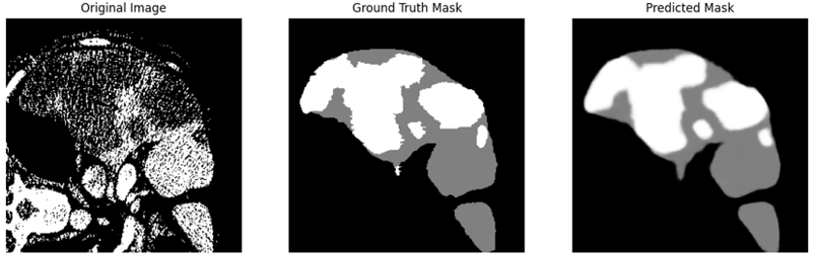
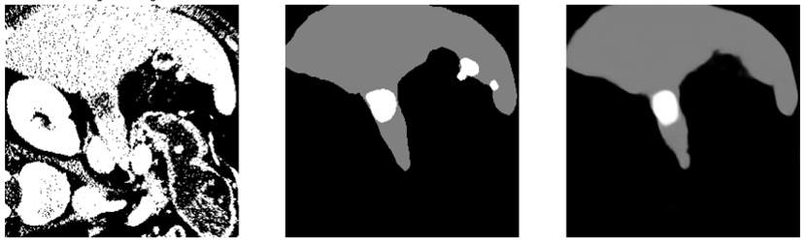
Trans-U-net

Slide 32
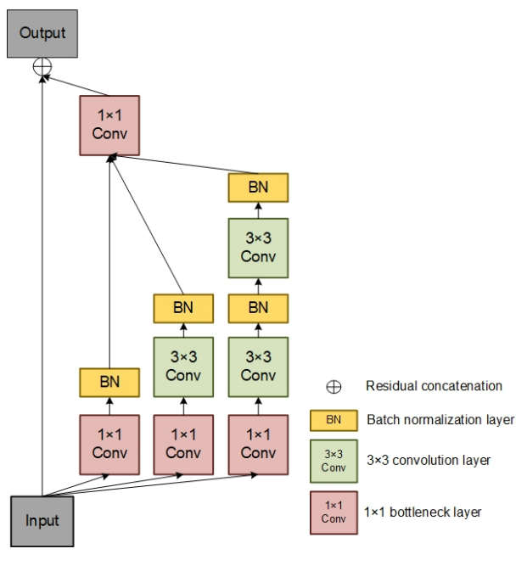
ResUnet
Integrate residual learning blocks into the traditional U-net architecture.
Improved feature propagation leads to better segmentation accuracy.
Residual units help mitigate the vanishing gradient problem by enabling deeper network architectures that capture detailed and complex image features without losing gradient flow during training.
Res Block
Notes:
Our last model is ResUnet, an advanced architecture that enhances our tumor segmentation capabilities:
Integration with Residual Blocks: Incorporates residual learning blocks into the traditional U-net framework. This helps prevent the vanishing gradient problem, allowing us to train deeper networks efficiently.
Deeper Networks: Thanks to these residual units, ResUnet can manage deeper layers without losing gradient flow during training. This depth is crucial for capturing more complex and detailed features in medical images.
Enhanced Feature Propagation: Improved propagation of features through the network results in more accurate and detailed segmentation of liver tumors.
Res Block:
The main idea of this block is to combine feature maps from different branches which helps to make the network wider and enables it to learn more features.
So, instead of learning a function without any reference, the Inception-Res block learns a function by considering the input feature maps which is an improvement for the learning process.

Slide 33
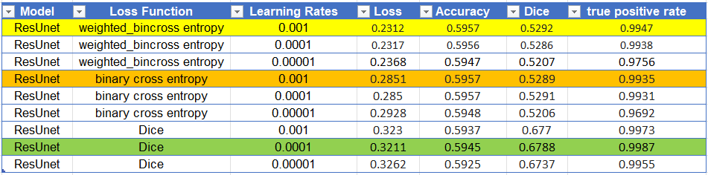
ResUnet
Notes:
Here are the results of our ResUnet model, employing various hyperparameters, learning rates, and loss functions.
Which we can see that…

Slide 34
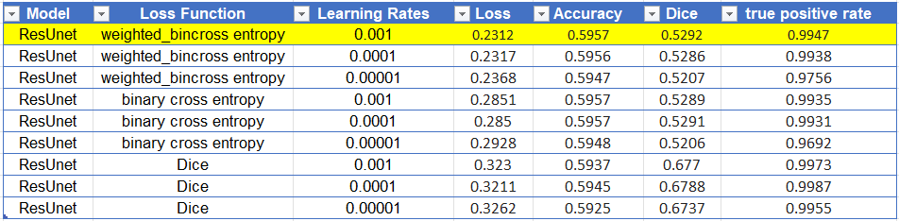
ResUnet
Notes:
The best performance was achieved with the model using weighted binary cross-entropy at a learning rate of 0.001, as highlighted in yellow.

Slide 35
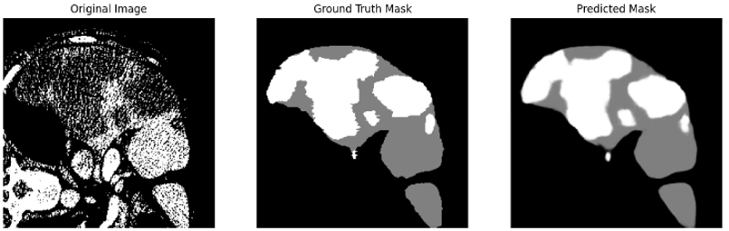
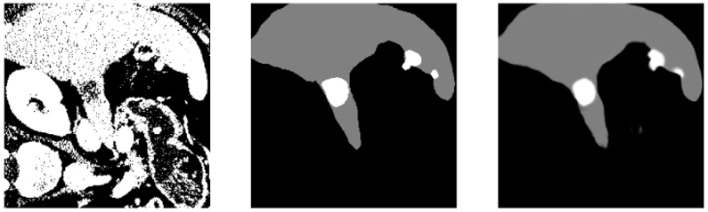
ResUnet
Notes:
These images show the segmentation results of ResUnet model. As you can see, this model provides the best predicted mask in both slices, this is the closest match to the ground truth.

Slide 36
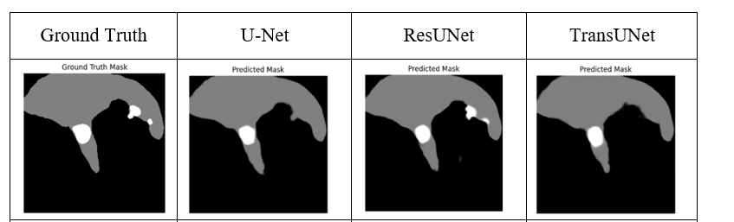
Results Comparison
Notes:
Let's now review a straightforward comparison of the models. As you can see from these images, ResUNet clearly delivers the best results among the three. This demonstrates its superior ability to accurately segment liver tumors compared to U-Net and TransUNet.

Slide 37
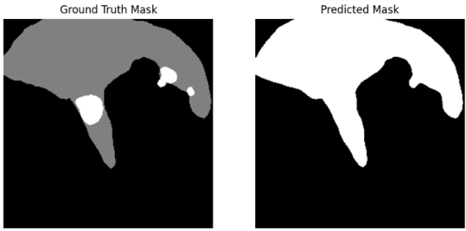
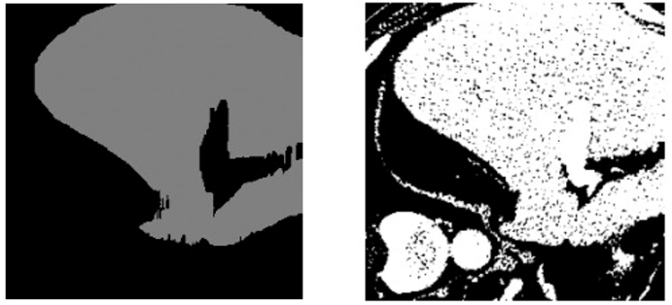
Challenges
Dice loss:
Despite the generally high-performance metrics reported when using Dice loss, the models tend to overlook the primary objective of segmenting both liver and tumors.
Noise in Dataset:
Manual examination revealed noise such as incorrect liver mask colorations, impacting model training and accuracy.
Computational Constraints:
Limited ability to enhance datasets or explore complex model architectures due to reliance on resources like Google-Colab.
Notes:
Dice Loss Issues: Although Dice loss is a popular metric due to its effectiveness in many scenarios, we observed that it sometimes leads to the model prioritizing the segmentation of the liver over detecting tumors. This misalignment can detract from our primary goal of accurately segmenting both liver and tumors.
Dataset Noise: Our manual inspections of the dataset revealed various types of noise, such as incorrect liver mask colorations. These inaccuracies can significantly affect the model's training and its subsequent accuracy, making robust pre-processing steps crucial.
Computational Constraints: Operating primarily on platforms like Google Colab limited our ability to work with large datasets or employ more computationally intensive model architectures. This restriction impacted our ability to explore some potentially beneficial approaches.
Each of these challenges taught us valuable lessons about the complexities of medical image analysis and has pointed us towards potential improvements in future iterations of our project.

Slide 38
Our Approach
Notes:
challenging task: for computers due to the diverse shapes, sizes, colors, textures, occlusions, and complex backgrounds.
1) Thresholding is a basic segmentation technique where pixels are divided into two segments based on a threshold value.
2) Adaptive Region Growing (ARG) starts with seed points and grows regions by adding adjacent pixels based on criteria like color and texture similarity.
3) Graph cut is a common method using graph representation, where nodes represent pixels and edges represent the similarity between pixels based on metrics like color and distance.
4) CNN-based segmentation models classify each pixel separately to the corresponding class, providing localization and segmentation.

Slide 39
Dual-Model
First Model:
Employs Dice loss
Segment the liver exclusively
Predicted liver serves as an additional input for the second model
Second Model:
Employs Weighted Binary Cross-Entropy
Segment tumors within the liver
Notes:
During our research, and through a detailed examination of our models' performance, we identified a new strategy to address the challenges encountered in segmenting liver tumors. Our observations indicated that while models utilizing Dice loss were proficient at delineating the liver, they were less effective at identifying tumors. Conversely, models employing Binary Cross-Entropy based loss functions experienced higher-than-expected losses, which we attributed to the non-binary nature of the dataset values.

Slide 40
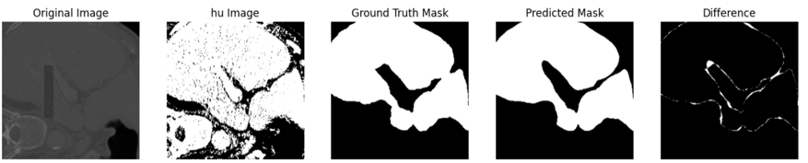

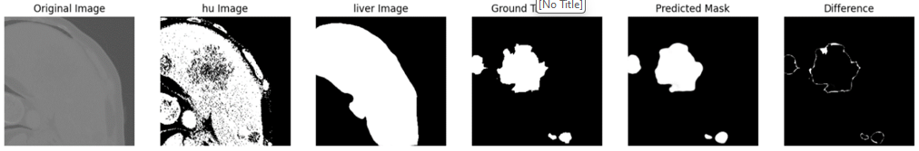
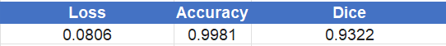
Dual-Model
First Model:
Second Model:

Slide 41
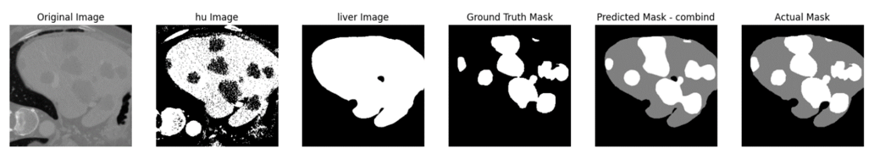
Dual-Model
Combined Results:
Notes:
The segmentation results from the first model reveal an incomplete liver delineation, with a small portion of the liver accidentally classified as background. Nonetheless, this outcome demonstrates the effectiveness of the second model, which reliably identifies tumors within the boundaries defined by the first model's liver segmentation, without attempting to re-segment the liver. Consequently, the second model exclusively focuses on detecting tumors within the liver regions previously identified, aligning perfectly with our project's objectives.

Slide 42
Conclusion
Notes:
challenging task: for computers due to the diverse shapes, sizes, colors, textures, occlusions, and complex backgrounds.
1) Thresholding is a basic segmentation technique where pixels are divided into two segments based on a threshold value.
2) Adaptive Region Growing (ARG) starts with seed points and grows regions by adding adjacent pixels based on criteria like color and texture similarity.
3) Graph cut is a common method using graph representation, where nodes represent pixels and edges represent the similarity between pixels based on metrics like color and distance.
4) CNN-based segmentation models classify each pixel separately to the corresponding class, providing localization and segmentation.

Slide 43

Conclusion
Comparative analysis of U-Net, ResUNet, and TransUNet for liver tumor segmentation.
Best models identified through varying loss functions and learning rates.
Dual-model approach significantly improved tumor detection accuracy.
Achievement
Met project benchmarks despite the tight schedule and challenging time that we are facing.
Our proposed approach to the segmentation task demonstrated that we even surpassed our initial objectives.
Notes:
Conclusion:
Comparative Analysis: We conducted a detailed comparison of U-Net, ResUNet, and TransUNet, highlighting the strengths and limitations of each model in liver tumor segmentation.
Optimal Models: Through rigorous testing of various loss functions and learning rates, we identified the most effective models, with ResUNet emerging as particularly powerful due to its precision and reliability.
Dual-Model Strategy: Our innovative dual-model approach leveraged the strengths of multiple architectures, significantly boosting tumor detection accuracy and demonstrating the potential of ensemble techniques in medical imaging.
Achievements:
Project Benchmarks: Despite a tight schedule and the substantial challenges we faced, not only did we meet our project benchmarks, but we also surpassed the initial objectives we set for ourselves.
Exceeding Expectations: Our proposed segmentation strategy not only met but exceeded expectations, offering insights into the potential for future advancements in medical diagnostic technologies.

Slide 44
Demonstration
Notes:
challenging task: for computers due to the diverse shapes, sizes, colors, textures, occlusions, and complex backgrounds.
1) Thresholding is a basic segmentation technique where pixels are divided into two segments based on a threshold value.
2) Adaptive Region Growing (ARG) starts with seed points and grows regions by adding adjacent pixels based on criteria like color and texture similarity.
3) Graph cut is a common method using graph representation, where nodes represent pixels and edges represent the similarity between pixels based on metrics like color and distance.
4) CNN-based segmentation models classify each pixel separately to the corresponding class, providing localization and segmentation.

Slide 45
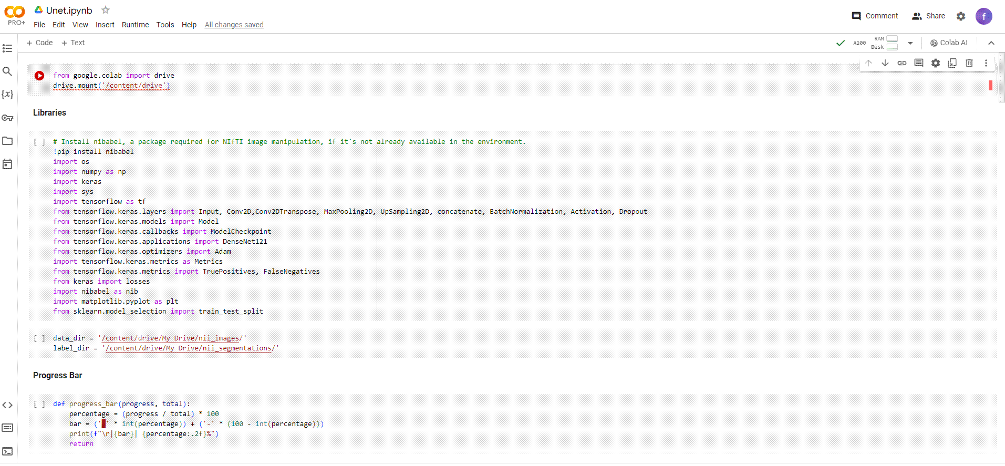
Mount To Drive:
Notes:
Dice loss:
Despite the generally high-performance metrics reported when using Dice loss, the models tend to overlook the primary objective of segmenting both liver and tumors. Instead, they focus on segmenting the liver alone, missing the broader task of segmenting both entities
Noise in Dataset:
Manual examination revealed noise such as incorrect liver mask colorations, impacting model training and accuracy.
Computational Constraints:
Limited ability to enhance datasets or explore complex model architectures due to reliance on resources like Google-Colab.

Slide 46
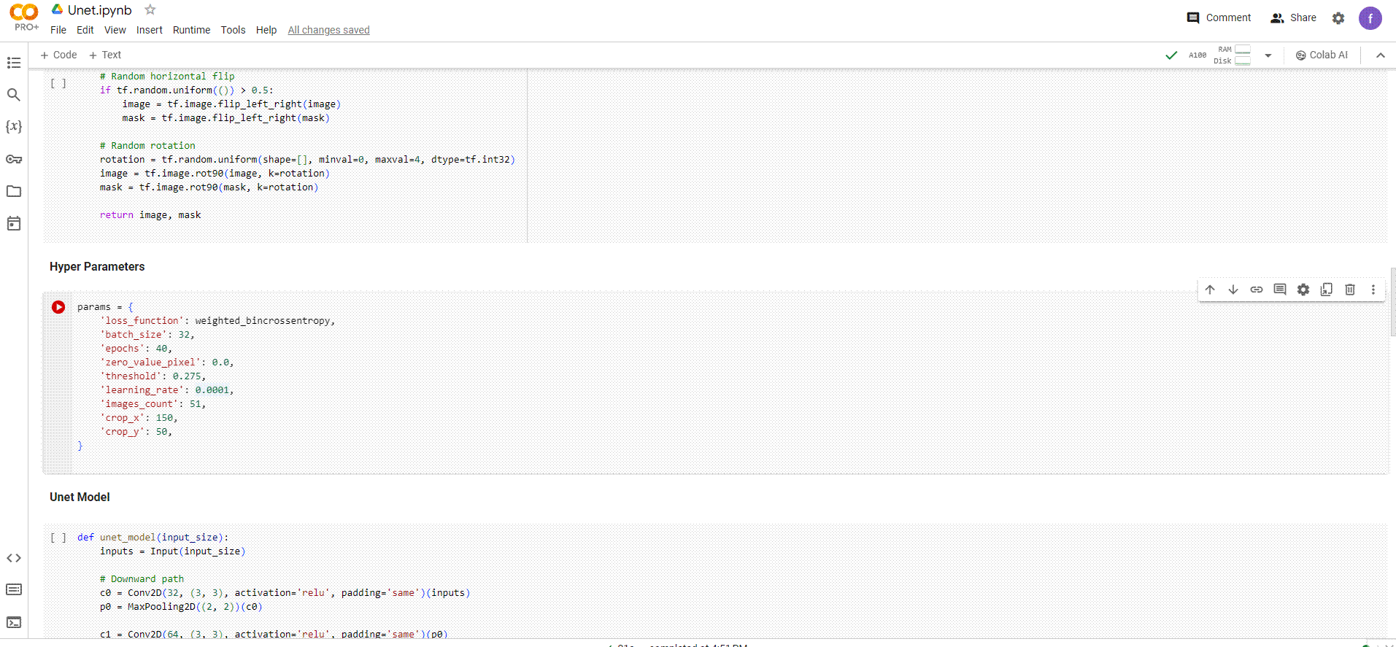
Change Hyper-Parameters:
Notes:
Dice loss:
Despite the generally high-performance metrics reported when using Dice loss, the models tend to overlook the primary objective of segmenting both liver and tumors. Instead, they focus on segmenting the liver alone, missing the broader task of segmenting both entities
Noise in Dataset:
Manual examination revealed noise such as incorrect liver mask colorations, impacting model training and accuracy.
Computational Constraints:
Limited ability to enhance datasets or explore complex model architectures due to reliance on resources like Google-Colab.

Slide 47
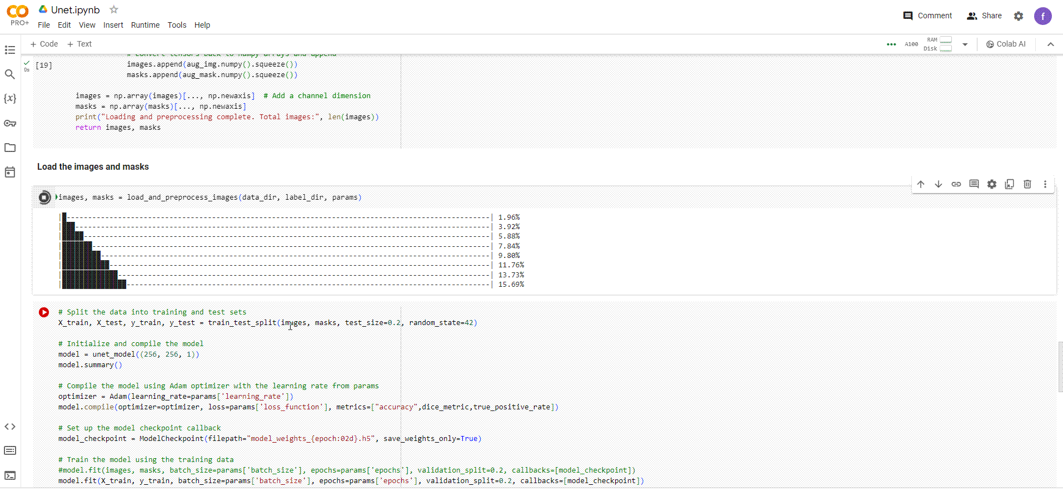
Load Dataset:
Notes:
Dice loss:
Despite the generally high-performance metrics reported when using Dice loss, the models tend to overlook the primary objective of segmenting both liver and tumors. Instead, they focus on segmenting the liver alone, missing the broader task of segmenting both entities
Noise in Dataset:
Manual examination revealed noise such as incorrect liver mask colorations, impacting model training and accuracy.
Computational Constraints:
Limited ability to enhance datasets or explore complex model architectures due to reliance on resources like Google-Colab.

Slide 48
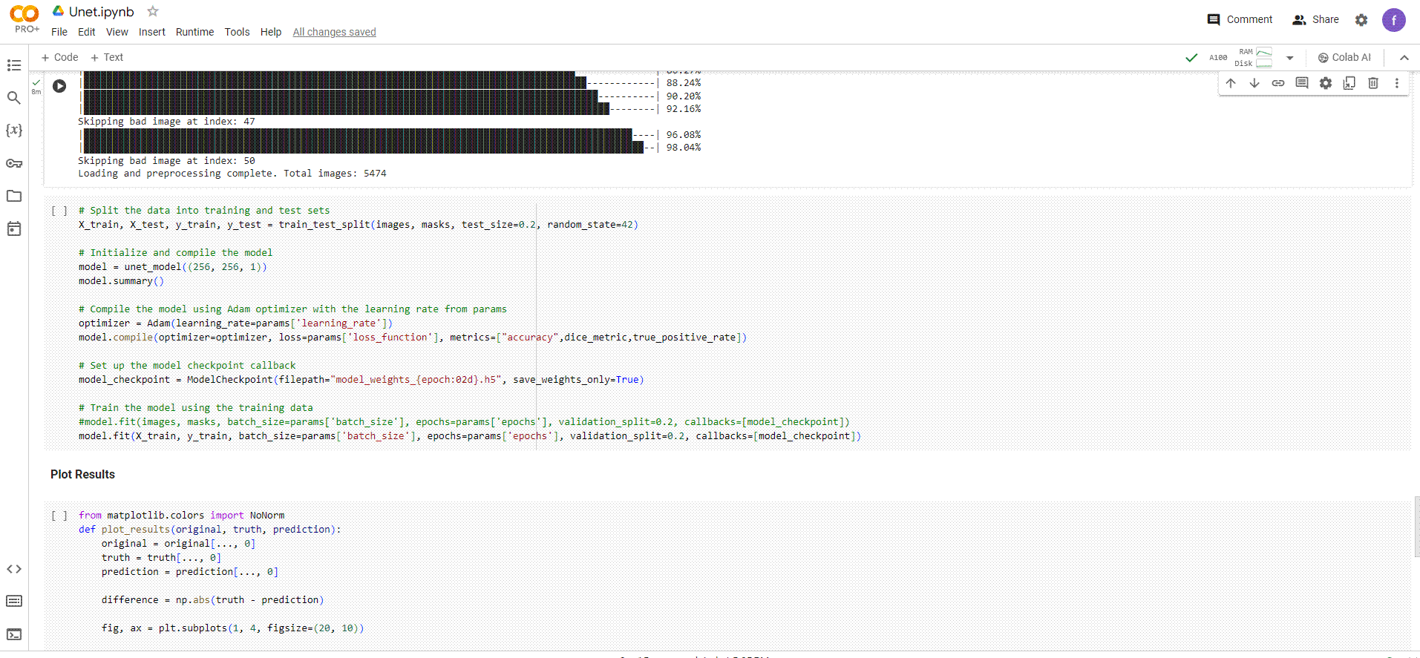
Train Model:
Notes:
Dice loss:
Despite the generally high-performance metrics reported when using Dice loss, the models tend to overlook the primary objective of segmenting both liver and tumors. Instead, they focus on segmenting the liver alone, missing the broader task of segmenting both entities
Noise in Dataset:
Manual examination revealed noise such as incorrect liver mask colorations, impacting model training and accuracy.
Computational Constraints:
Limited ability to enhance datasets or explore complex model architectures due to reliance on resources like Google-Colab.

Slide 49
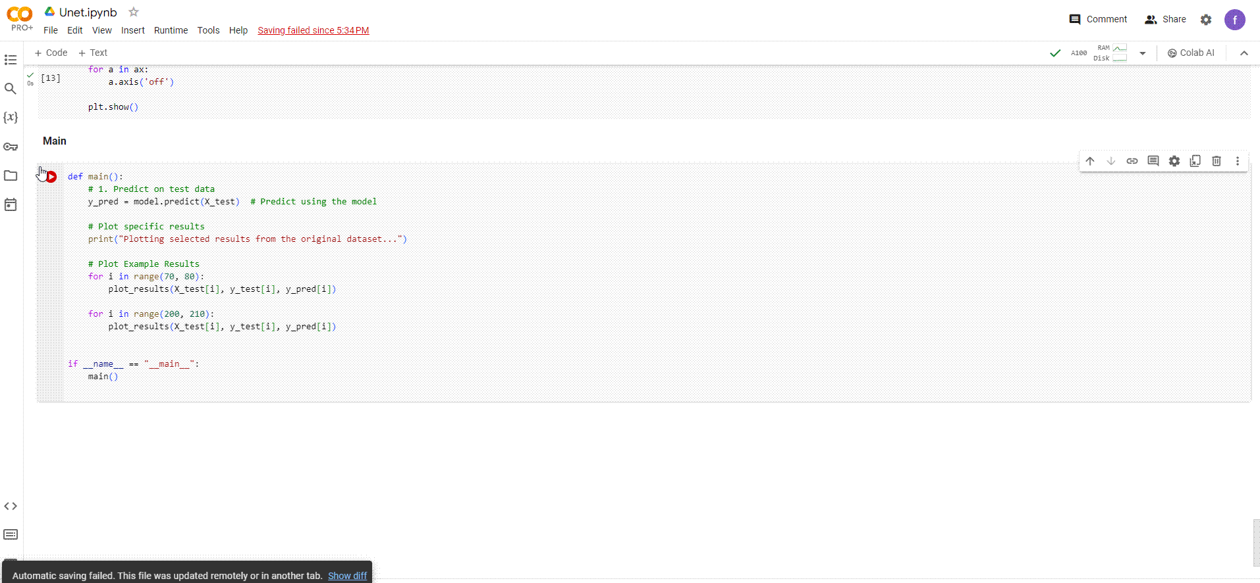
Plot Results:
Notes:
Dice loss:
Despite the generally high-performance metrics reported when using Dice loss, the models tend to overlook the primary objective of segmenting both liver and tumors. Instead, they focus on segmenting the liver alone, missing the broader task of segmenting both entities
Noise in Dataset:
Manual examination revealed noise such as incorrect liver mask colorations, impacting model training and accuracy.
Computational Constraints:
Limited ability to enhance datasets or explore complex model architectures due to reliance on resources like Google-Colab.

Slide 50

THANK YOU FOR LISTENING ☺

